Slide 1
AI Stock Analyst:
Colloquium
Sai Dheeraj, Gummadi
Financial Chatbot using
Large Language Models
India, 20/February/2025

Slide 2
Content list
Introduction and Background |  | 1 |  | 00:07 h
Literature Review |  | 2 |  | 00:03 h
Methodology |  | 3 |  | 00:15 h
Experimental Results and Analysis |  | 4 |  | 00:03 h
Conclusion and Future Work |  | 5 |  | 00:03 h

Slide 3
Introduction and Background

Slide 4
Overview
Problem Statement
Bridging the gap in financial stock analysis
Explainable Stock Analysis
Fundamental and Technical Analysis
Upto date data
Importance of Stock Analysis
Critical for informed investment decisions
Need for timely and accurate insights
90% of Indian investors end up making losses [1]

Slide 5
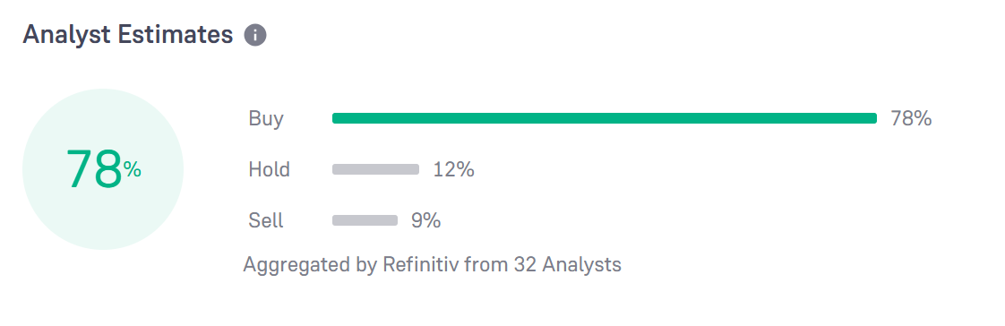
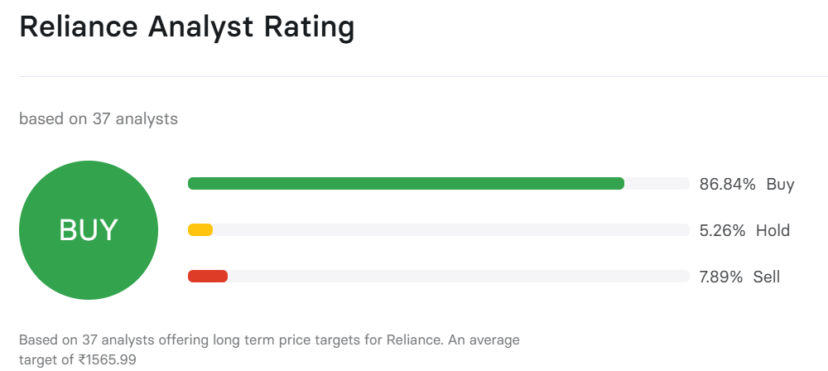
The Evolving Landscape of Financial Markets
Challenges in Current Stock Analysis
Lack of transparency in predictive models
Opaque recommendations lead to investor mistrust
Demand for Explainable Stock Recommendations
Investors require clear justifications for forecasts
Enhances trust and facilitates better decision-making
Opportunity for Innovation
Development of self-reflective large language models (LLMs)
Ability to analyze unstructured data and provide insights
Reliance Industries Analyst Suggestion from Groww
Reliance Industries Analyst Suggestion from INDMoney

Slide 6
Literature Review
02

Slide 7
Literature Review
Key Studies and Their Findings:
Kirtac and Germano [2] worked on sentiment based trading using OPT, BERT, FinBert
Kim et al [3] explores the capabilities of GPT-4 Turbo for company’s future performance.
Guo and Hauptmann [4] explored the application of LLMs in forecasting stock returns using financial news.
Haowei Ni et al [5] built a Buy, Hold, Sell prediction model using Llama-3-8b-instruct model.
Gaps in Existing Research:
Overlooked insights financial reports.
Lack of explainability.
Underexplored integration of NLP with financial data analysis
Relevance to My Work:
Leveraging LLMs for improved financial fraud detection
Utilizing comprehensive financial data from Alpha Vantage API
Enhancing customer service through chatbot integration
Bridging gaps in current research to develop reliable financial analysis tools

Slide 8
METHODOLGY
03

Slide 9
Research Framework
Overview of the Methodology:
Integration of advanced NLP techniques, dynamic data retrieval systems, and LLMs
Steps: Data collection, data processing, and integration of LLMs with RAG pipelines
Goal: Enhance accuracy and efficiency in stock market analysis.
Data:
Identification of target companies from Yahoo Finance.
Collection of detailed stock information: EPS trends (90, 60, 30 days), current EPS, growth estimates, etc..,
Gathering related news articles for sentiment analysis.
LLM and RAG Architecture:
- Addressing limitations of traditional LLMs with RAG.
- RAG model phases: Retrieval and Generation.
- Use of LangChain framework for building RAG system.

Slide 10
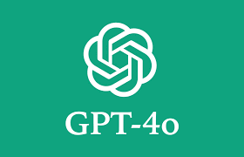

Technical Components
GPT-4o and Gemini 1.5 Flash
GPT-4o:
Developed by OpenAI
Transformer Architecture
Gemini 1.5 Flash
Developed by Google
Sparse mixture-of-experts (MoE)
Evaluation
Bad Speculative Detector
Like and Dislike Response
Context switching
Similarity between Question and Response

Slide 11
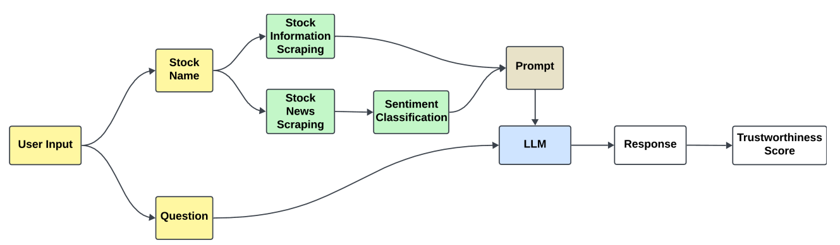
Implementation
Scraper Service: Data retrieval from Yahoo Finance and News
Sentiment Analysis Service: Sentiment score generation
LLM Service: Response generation using pre-trained LLM

Slide 12
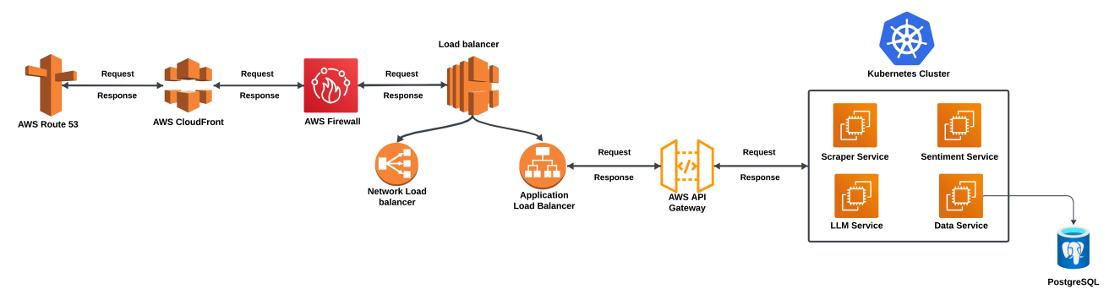
Request Response Journey
Route 53(DNS): Directs user to closest server
CloudFront(CDN): Cache frequently queried content
Firewall: Filters malicious traffic
Network Load balancer: Low latency and High Throughput
Application Load balancer: Host based routing
API gateway: Rate-limiting and throttling

Slide 13
Results
04

Slide 14
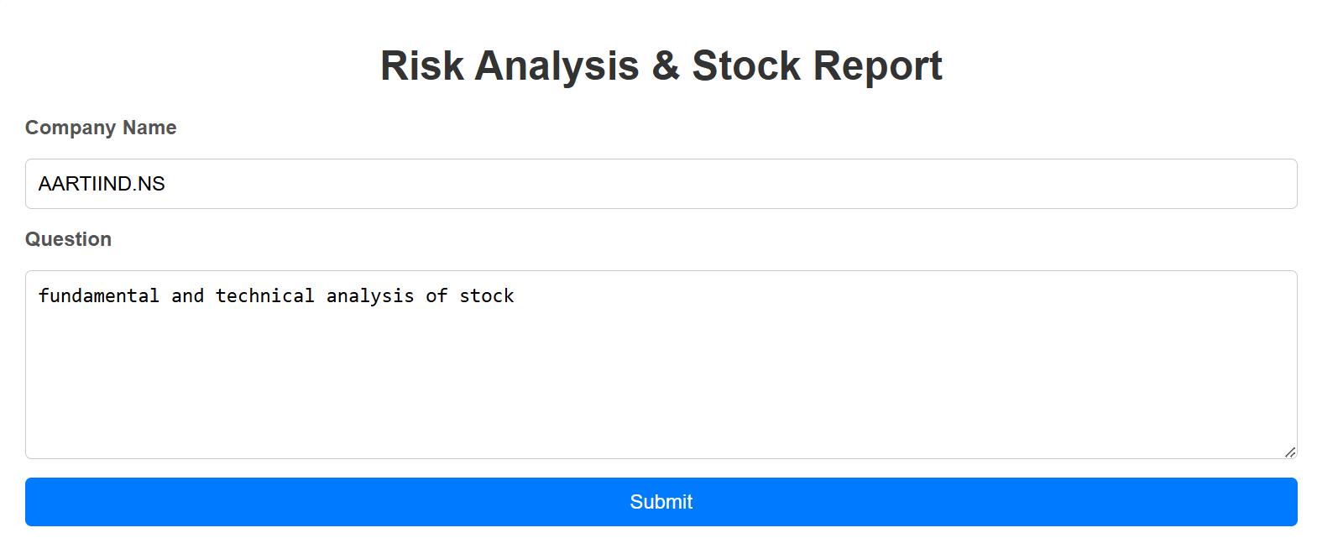
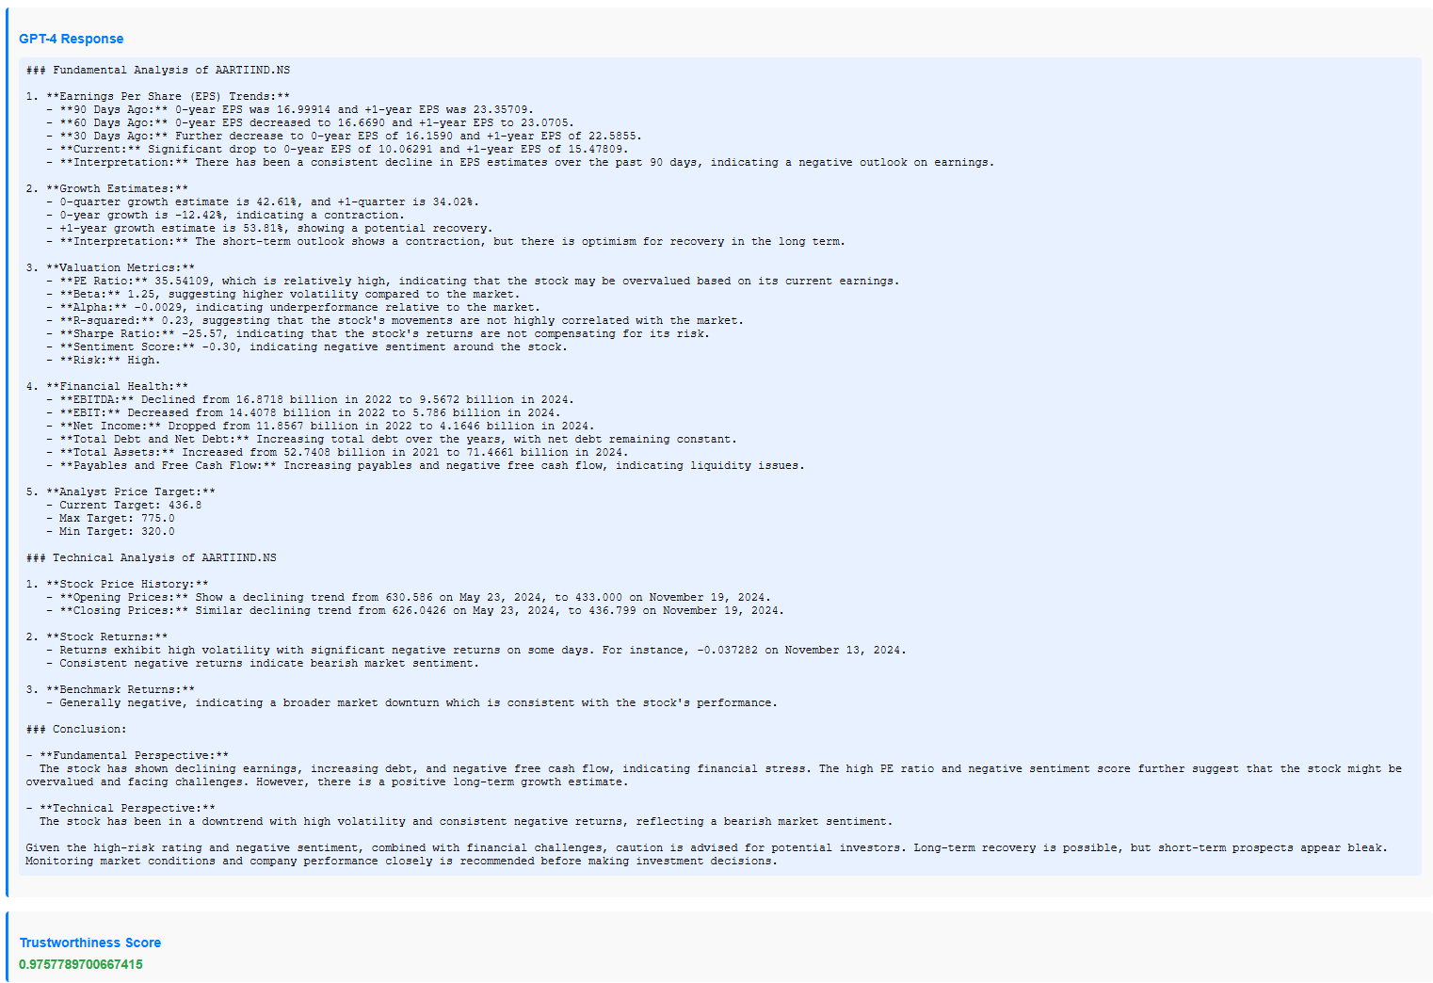
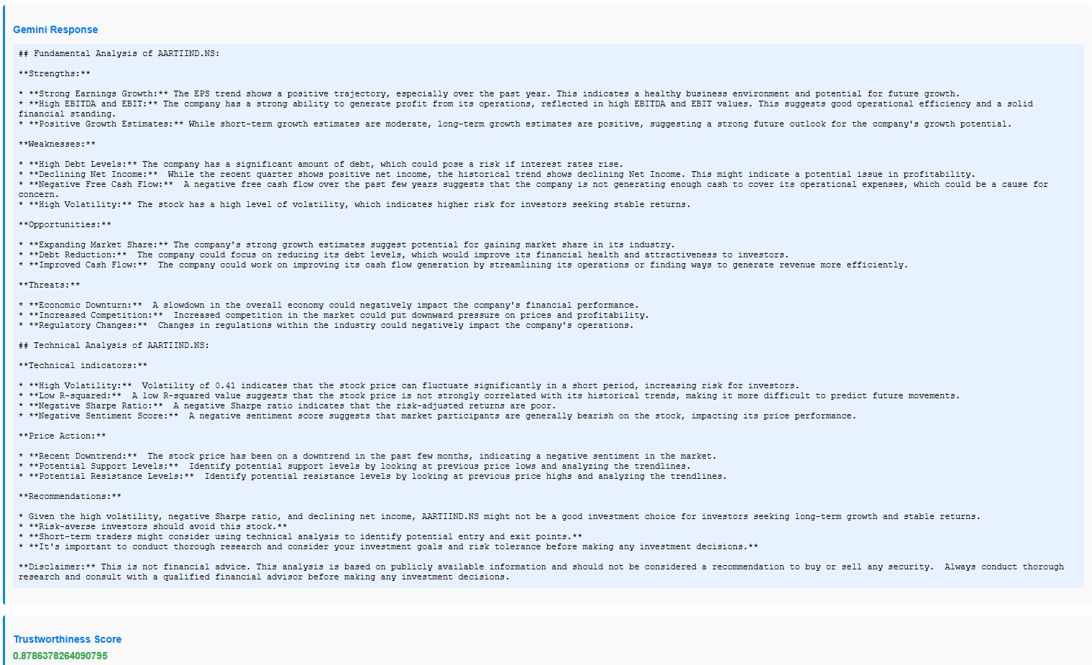
Experimental Results

Slide 15
ANAlysis and Findings
Insights from the Results:
Improved Accessibility of Information:
Real-time, comprehensive stock analysis reports
Facilitates accurate and timely investment decisions
Real-Time Updates:
Reflects the latest data
Enables swift reaction to market volatility
Implications for Investors:
Enhanced Decision-Making:
Informed decisions with comprehensive, up-to-date reports
Time Efficiency:
Automated report generation saves time and effort
Broader Market Perspective:
Insights into market trends, financial health, and news events

Slide 16
Conclusion and Future work
05

Slide 17
Conclusion
Significant Advancement: The chatbot integrates LLMs with dynamic data retrieval, revolutionizing financial analysis.
Accessibility: Aims to make sophisticated financial insights available to a broader audience of investors.
Empowerment: Designed to help investors make informed and effective investment decisions.
Impact: Enhances utility and influence within the financial sector, fostering better investment strategies.

Slide 18
Future work
Personalized Investment Advice: The chatbot offers tailored recommendations based on individual financial situations, goals, and risk tolerance, enhancing investment decision-making for users.
Risk Assessment: The chatbot evaluates potential investment risks by analyzing market volatility, sector exposure, and individual stock performance, helping users make informed decisions.
Integration of Additional Data Sources: Expand the chatbot’s capabilities by incorporating more financial data sources (e.g., direct broker feeds, alternative data providers) to increase the breadth and depth of analysis.
Prompt Fine tuning: Defining specific responsibilities and behaviour of the model and explain the constraints.
Prompt Customization: Sector wise customized prompt using prompt routing technique.

Slide 19
References
Anand, N., & Gupta, K. (2024, September 24). Trapped in the game: 93% of F&O traders lose money but refuse to quit. Why? Business Standard. https://www.business-standard.com/markets/stock-market-news/trapped-in-the-game-93-of-f-o-traders-lose-money-but-refuse-to-quit-why-124092400536_1.html
Kemal Kirtac and Guido Germano. “Sentiment trading with large language models”. In: Finance Research Letters 62 (2024), p. 105227.
Alex Kim, Maximilian Muhn, and Valeri Nikolaev. “Financial statement analysis with large language models”. In: arXiv preprint arXiv:2407.17866 (2024).
Tian Guo and Emmanuel Hauptmann. “Fine-tuning large language models for stock return prediction using newsflow”. In: arXiv preprint arXiv:2407.18103 (2024).
Haowei Ni et al. “Harnessing earnings reports for stock predictions: A qlora-enhanced llm approach”. In: 2024 6th International Conference on Data-driven Optimization of Complex Systems (DOCS). IEEE. 2024, pp. 909–915.

Slide 20
Thank you
Address 1
Address 2
Address 3
Contact Name 0123 456789
max@online.com

